Slide 1
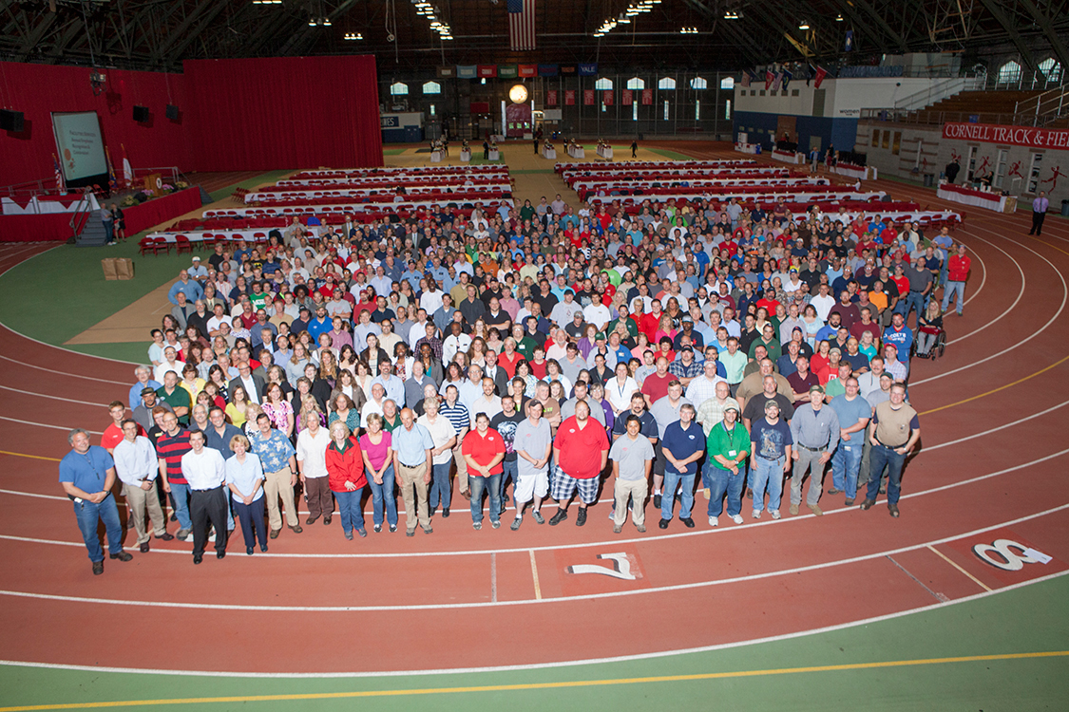
2016 and Beyond: Supervisor Expectations

Slide 2
Agenda
Mission and Vision (Kyu 10 minutes)
Alignment of goals: Cornell University → Infrastructure Properties and Planning→ Department → Individual (Kyu 20 minutes)
Our Values (Kyu or Designate 15 minutes)
Our Culture (IPP HR 15 minutes)
Expectations
  Managing Priorities (IPP HR 5 minutes)
  Staff Development (IPP HR 10 minutes)
  Diversity and Inclusion (IPP HR 10 minutes)
Take-aways (5 minutes)
Notes:
Kyu

Slide 3
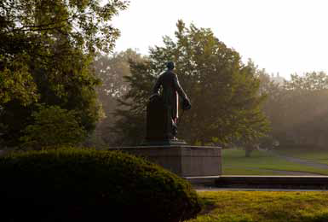
CORNELL’S Mission
“I would found an institution where any person can find instruction in any study.”
Ezra Cornell, 1868
CORNELL’S MISSION - Cornell's mission is to discover, preserve, and disseminate knowledge; produce creative work; and promote a culture of broad inquiry throughout and beyond the Cornell community. Cornell also aims, through public service, to enhance the lives and livelihoods of our students, the people of New York, and others around the world.
Notes:
Kyu

Slide 4
Visions
Visions should be set based on what success would look like a number of years from now, when you have accomplished your greatest goals and aspirations for the place
Visions should reflect BHAGs (big, hairy, audacious goals), not successes you are sure you can achieve
Notes:
Kyu

Slide 5
Examples of visions
Merck
Amazon
We make a difference in the lives of people globally through our innovative medicines, vaccines, and consumer health ands animal products. We aspire to be the best healthcare company in the world and are dedicated to providing leading innovations and solutions for tomorrow.
Our vision is to be the earth’s most customer-centric company; to build a place where people can come to find and discover anything they might want to buy on line.
Notes:
Kyu

Slide 6
Cornell’s vision
Cornell University will be widely recognized as a top-ten research university in the world, and a model university for the interweaving of liberal education and fundamental knowledge with practical education and impact on societal and world problems.
Notes:
Kyu

Slide 7
Infrastructure properties and planning
“We have not invited you to see a university finished, but to see one begun.”
- Ezra Cornell
MISSION – Create and steward a dynamic environment in support of the University’s mission.
VISION – Accelerate the transformation of the University into a world recognized model of excellence, innovation, and sustainability.
Notes:
Kyu

Slide 8
Goal Alignment
University
a. Faculty Excellence
Infrastructure Properties and Planning
1. Accelerate Climate Action
Department Goals
Individual Goals
b. Educational Excellence
c. Excellence in Research
d. Scholarship & Creativity
e. Staff Excellence
f. Excellence & Organizational Stewardship
2. Build trust w/ partners
3. Enhance comm/outreach
4. Pursue livable, economically sustainable and accessible communities
5.Generate external revenue for the University
6. Develop funding strategy to achieve priority goals
7. Minimize recharge of University dollars
8. Create an integrated capital planning process
9. Attain a responsible maintenance backlog
10.Improve, streamline and document processes
11.Identify, develop, implement metrics 12.Prepare staff for succession into critical roles
13.Create career -broadening opportunities
14.Build engaged culture for continuous improvement
Notes:
Kyu

Slide 9
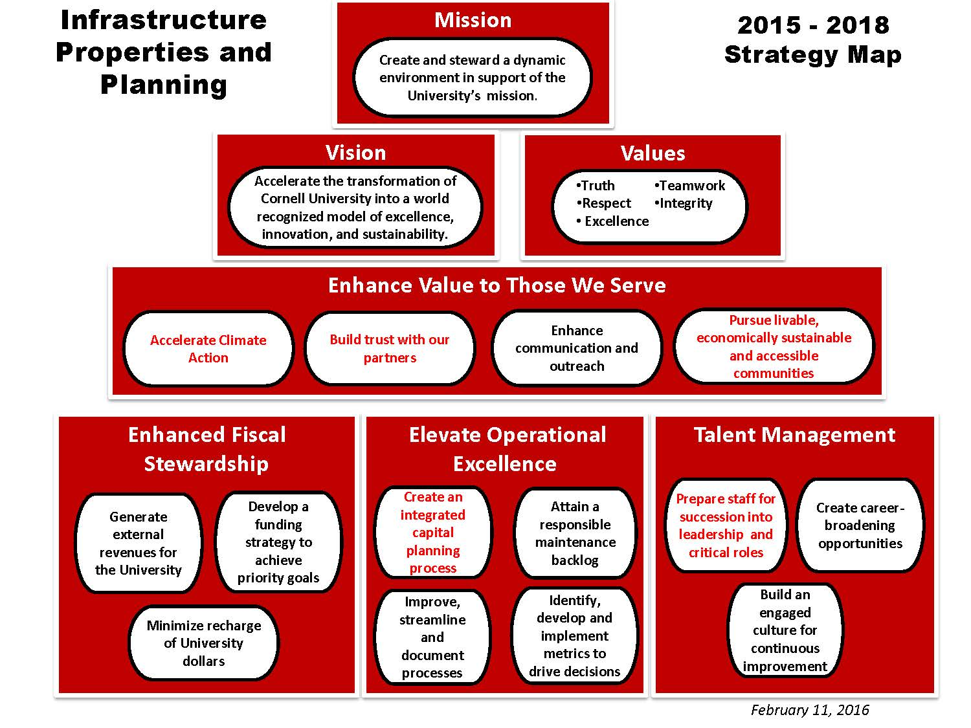

Slide 10
Our Values
Infrastructure Properties and Planning Values
Truth
We say what we mean and do what we say
Respect
We treat people as we want to be treated
Excellence
We strive to be the best
Teamwork
Together we achieve more
Integrity
We do the right thing
Notes:
Donna-Marie?? Bob to verify/update University Values

Slide 11
Our Culture – Small group discussion
1. What aspects of the IPP culture are going well?
2. What could be improved?
3. How do you, as IPP supervisors, influence the culture?
4. What tools do you use, as IPP supervisors, to positively influence the culture?
Notes:
Donna-Marie
Split in groups. Have groups answer questions.
Debrief specifically addressing #3.

Slide 12
Our Culture – Small group discussion
4. What tools do you use, as IPP supervisors, to positively influence the culture?
Notes:
Donna-Marie
Split in groups. Have groups answer questions.
Debrief specifically addressing #3.

Slide 13
expectations
Managing Priorities
Staff Development
Diversity and Inclusion
Notes:
Donna-Marie

Slide 14
Managing Your Priorities – Where is your focus?
Goals
Manage
Lead
Staff
Notes:
Donna-Marie
Goals:
Develop specific goals (SMART and clear)
Organize work
Promoting Cornell’s and IPPs values to ensure a positive and respectful environment
Staff:
Establish and communicate expectations for staff
Understand your staffs’ skills (where do they excel?)
Maximize your team’s skills
Managing and leading go hand in hand; they are linked, but they are not the same thing.
Manage:
Consistency in practices
Timely feedback (good and constructive)
Determine goals
Plan and organize work striving for efficiency AND while maximizing your staffs’ skills
Proactively develop talent
Lead
Encourage and empower staff
Inspire and motivate results
Be innovative and lead change
Long-range planning
Serve as one voice and steward for IPP and the University
Communicate and support IPPs initiatives and goals

Slide 15
Why staff development?
28% of IPP staff are eligible to retire NOW
44% of IPP staff are eligible to retire in NEXT 5 YEARS
Increased Retention
Increased Productivity
Decreased Absenteeism
Notes:
Donna-Marie (Data taken on 8/15/2016)
One reason to consider staff development is succession planning.
As many of you are aware, several of your colleague over the past few years have retired.
Other reasons include:
Retention; job satisfaction
Increased productivity
Decreased absenteeism

Slide 16
Staff development – Who’s responsibility is it?
Individual
Develop career goals
Cornell/IPP
Create expectations for a culture of development
Supervisor
Support needs and goals
Initiative to learn and develop
Reach out for opportunities/training
Provide connections and resources
Advocate for high performing staff
Follow through on commitments
Provide framework for succession planning/development
Notes:
Donna-Marie
It is everyone’s responsibility BUT primarily the employee’s responsibility.
Some employees do not recognize this and it is your role as a supervisor to guide them and set the expectation.

Slide 17
Staff development Options
Stretch Assignments
Committees
Task Forces
Project Leaders
Community Volunteerism
Cross Training
Trainings
Presentations
Rotational Assignments
IPP LEAD Program
Job Shadowing
Mentor Relationships
Notes:
Donna-Marie
Over the past _____3___ years, we have had _63 of successful rotations with 18 leading to promotions
Very positive
Increases morale
Motivates staff
Enhances their portfolio and chances for promotion

Slide 18
Supervisor’s Role in Developing STaff
Support your top performers’ movement - They are our future
Spend time with your high performers
Encourage your direct reports to take initiative
Provide resources and direction
Plan for the future – make succession plans
Be creative in development plans
  Consider rotational assignments
  Set up informal mentorships
Ideally, discuss development with your staff quarterly
Notes:
Donna-Marie

Slide 19
Diversity and inclusion
IPP Diversity Committee - 2016 Goals
(COMPOSITION) IPP Workforce Diversity
  Year 1: Determine focus areas (titles that reflect the highest percentage of underrepresentation) and develop outreach plans for these IPP focus areas.
  Year 2: Implement the outreach plans and evaluate metrics to determine if applicant pools reflect an increase in underrepresented candidates.
2. (ENGAGEMENT) Inclusiveness Training for IPP Staff
  Assess culture of IPP and identify training options
3. (ENGAGEMENT) Community Outreach
  Continuing outreach to underrepresented and diverse groups within Ithaca and surrounding communities to increase awareness of apprenticeship programs and employment opportunities within IPP.
Notes:
Donna-Marie

Slide 20
Diversity and inclusion
Front Seat/Back Seat/Trunk
Notes:
Donna-Marie
Bob to do Front Seat/Back Seat/Trunk activity – time permitting

Slide 21
Questions ?
Notes:
Donna-Marie -
The New Super Food – in preparation for Managing Through Change

